Slide 1
Flight Fare
Prediction
Submitted to : Ali Nouhi

Slide 2

Group Members
Dev Makwana - C0885064
Joel Crasto - C0883863
Krina Patel - C0886861
Mahaveersinh Chauhan - C0884854
Trushna Patel – C0886910

Slide 3
Table of contents
01
02
03
04
05
06
07
08
Introduction
About Data
Exploratory Data Analysis (EDA)
Feature Selection
Methods Used
Results
Conclusions
References

Slide 4
01
Introduction

Slide 5
Introduction
Airline customer satisfaction is a crucial aspect of the aviation industry.
Customer loyalty varies with small changes in the service.
Therefore, companies need to understand customer’s need to deliver excellent services to retain customers.
High customer satisfaction can result in increased customer loyalty, positive word-of-mouth advertising, and repeat business.

Slide 6
Problem Statement
We will identify either customers are satisfied or not satisfied, based on the ratings on various aspects of airline experience.
Accordingly, the respective airlines can find out the factors related to high satisfaction

Slide 7
02
About Data

Slide 8
Dataset Source
Airline Passenger Satisfaction : Kaggle Dataset
This dataset contains an airline passenger satisfaction survey.
Published by : TJ Klein
Source: https://www.kaggle.com/datasets/teejmahal20/airline-passenger-satisfaction?select=train.csv

Slide 9
Description of Data
Gender: Gender of the passengers (Female, Male)
Customer Type: The customer type (Loyal customer, disloyal customer)
Age: The actual age of the passengers
Type of Travel: Purpose of the flight of the passengers (Personal Travel, Business Travel)
Class: Travel class in the plane of the passengers (Business, Eco, Eco Plus)
Flight distance: The flight distance of this journey
Inflight wifi service: Satisfaction level of the inflight wifi service (0:Not Applicable;1-5)
Departure/Arrival time convenient: Satisfaction level of Departure/Arrival time convenient
Ease of Online booking: Satisfaction level of online booking
Gate location: Satisfaction level of Gate location
Food and drink: Satisfaction level of Food and drink
Online boarding: Satisfaction level of online boarding

Slide 10
Description of Data
Seat comfort: Satisfaction level of Seat comfort
Inflight entertainment: Satisfaction level of inflight entertainment
On-board service: Satisfaction level of On-board service
Leg room service: Satisfaction level of Leg room service
Baggage handling: Satisfaction level of baggage handling
Check-in service: Satisfaction level of Check-in service
Inflight service: Satisfaction level of inflight service
Cleanliness: Satisfaction level of Cleanliness
Departure Delay in Minutes: Minutes delayed when departure
Arrival Delay in Minutes: Minutes delayed when Arrival
Satisfaction: Airline satisfaction level(Satisfaction, neutral or dissatisfaction)

Slide 11
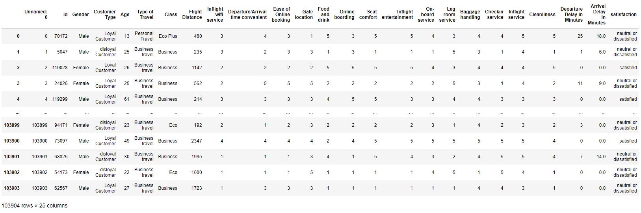
Original Data

Slide 12
03
Exploratory Data Analysis

Slide 13
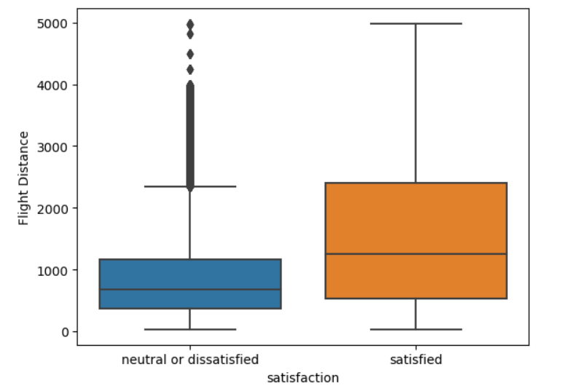
Satisfaction Based Flight Distance Box Plot

Slide 14
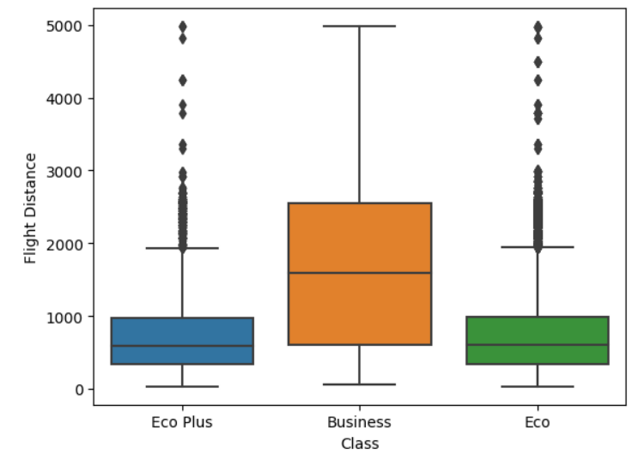
Class Based Flight Distance Box Plot

Slide 15
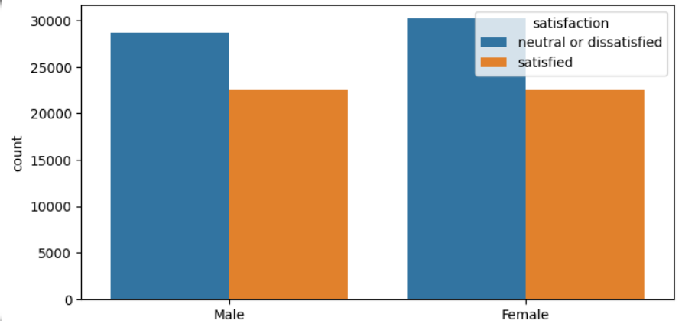
Gender Based Satisfaction Count Plot

Slide 16
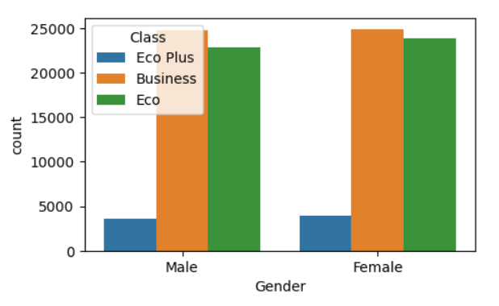
Gender Based Class Count Plot

Slide 17
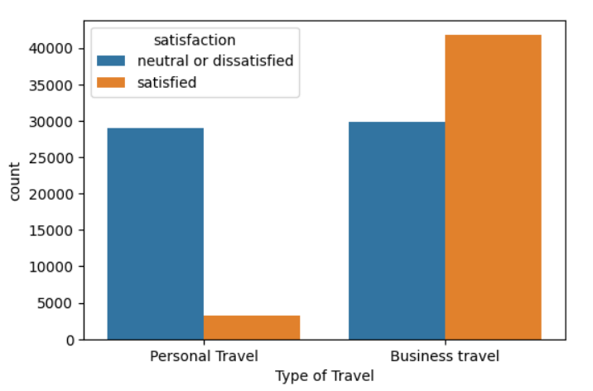
Type Of Travel Based Satisfaction Count Plot

Slide 18
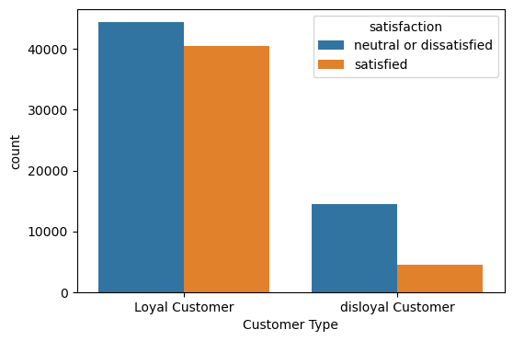
Customer Type Based Satisfaction Count Plot

Slide 19
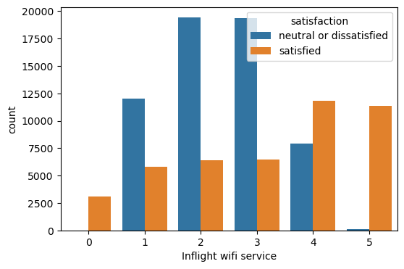
Wifi Service Based Satisfaction Count Plot

Slide 20
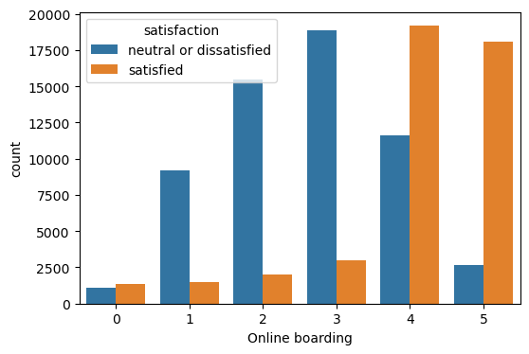
Online Boarding Based Satisfaction Count Plot

Slide 21
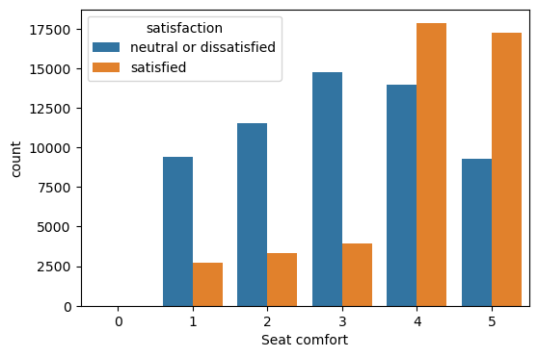
Seat Comfort Based Satisfaction Count Plot

Slide 22
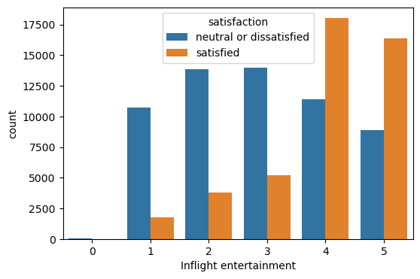
Inflight Entertainment Based Satisfaction Count Plot

Slide 23
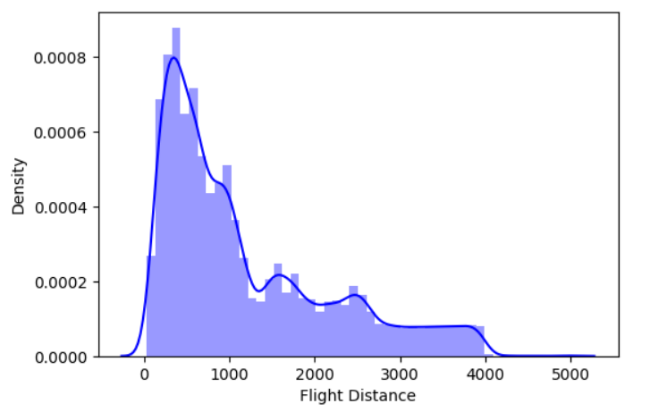
Histogram Of Flight Distance

Slide 24
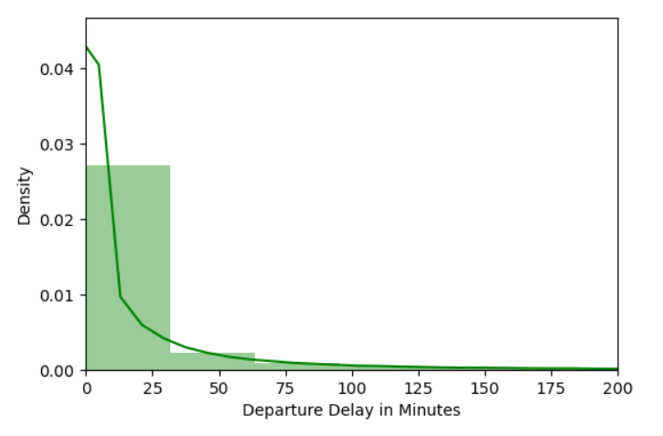
Histogram Of Depart Delay In Minutes

Slide 25
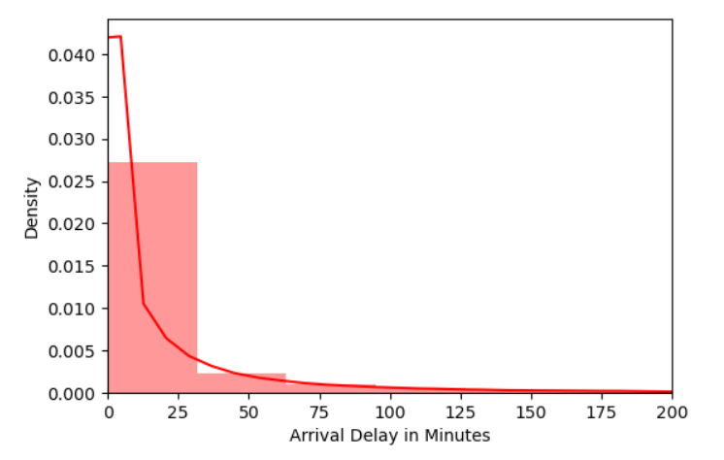
Histogram Of Arrival Delay In Minutes

Slide 26
04
FEATURE SELECTION

Slide 27
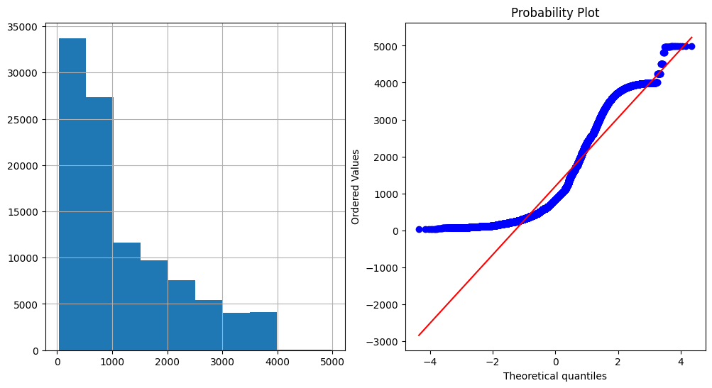
Original Distribution

Slide 28
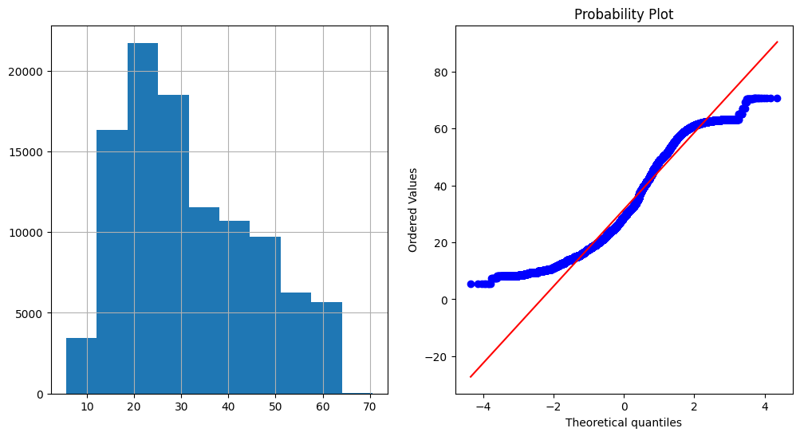
Square Root Transformation

Slide 29
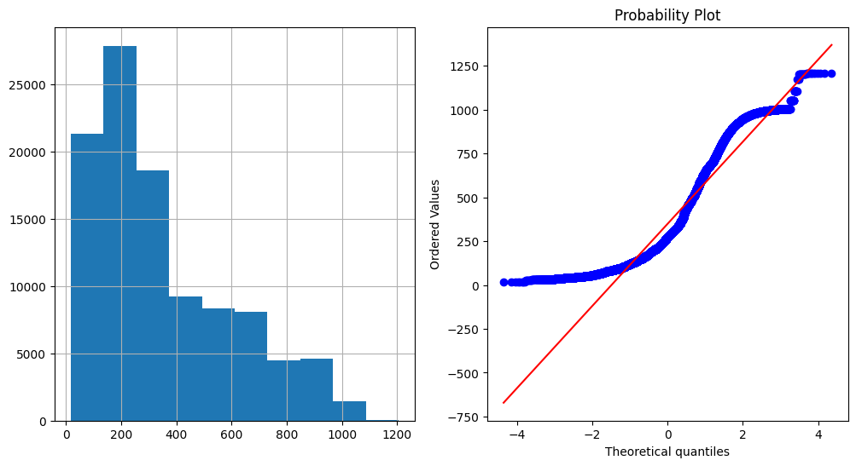
Exponential Transformation

Slide 30
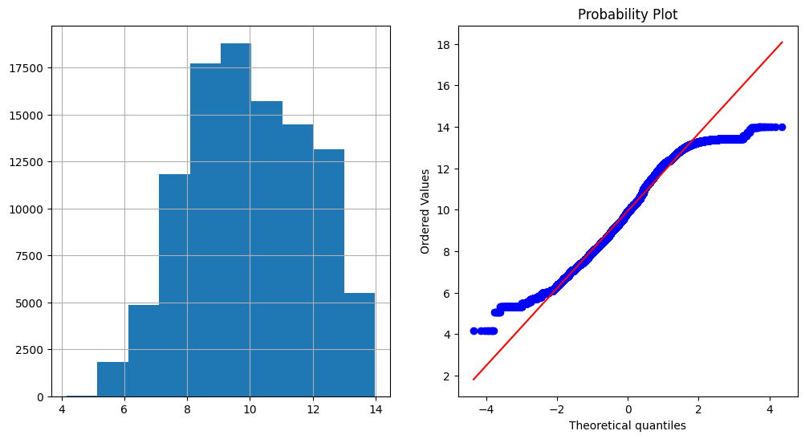
Box-Cox Transformation

Slide 31
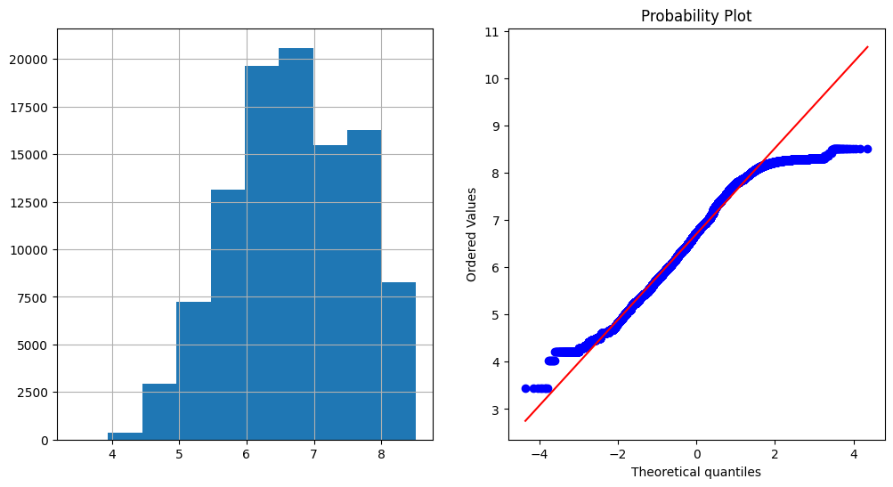
Logarithmic Transformation

Slide 32
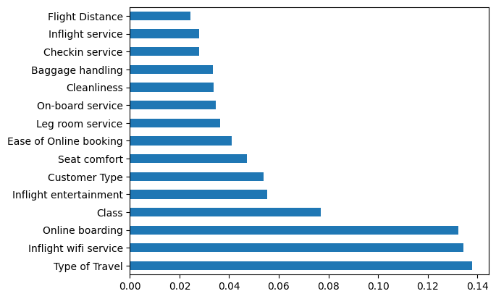
Feature Selection
We apply Standard Scaler to normalize whole dataset.
Feature Selection using ExtraTreesClassifier.
We have shortlisted top 15 feature for the training set.
We split the dataset by 80-20 % for training and testing.

Slide 33
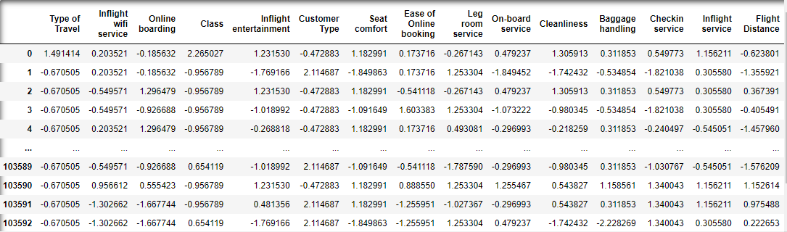
Normalized Dataset

Slide 34
05
Methods Used

Slide 35
Decision Tree Classification
Split data in 80-20%
Graphical representation model to make decision for classification
Hyper parameter tuning with GridSearchCV
GridSearchCV to try all possible combinations for hyperparameters

Slide 36
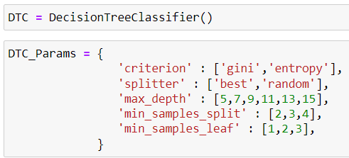
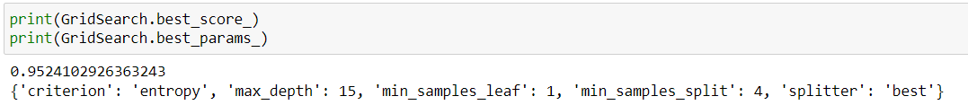
Decision Tree Classification
Hyper parameters:
criterion
splitter
max_depth
min_samples_split
min_samples_leaf

Slide 37
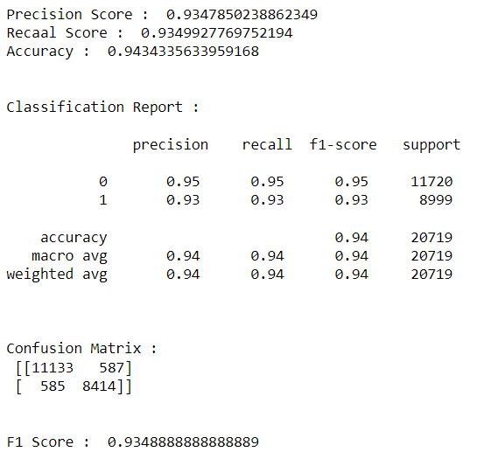
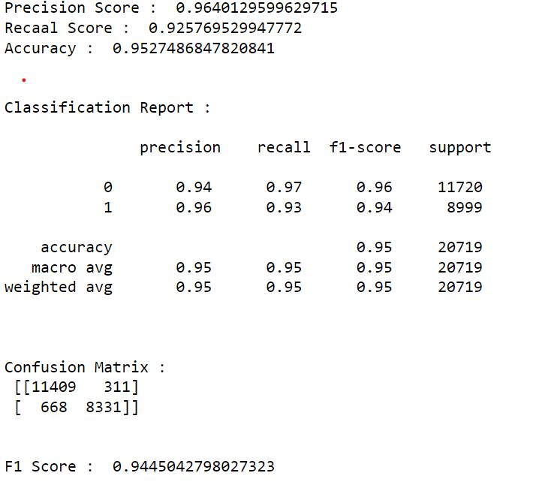
Results
Before Hyper parameter tuning
After Hyper parameter tuning

Slide 38
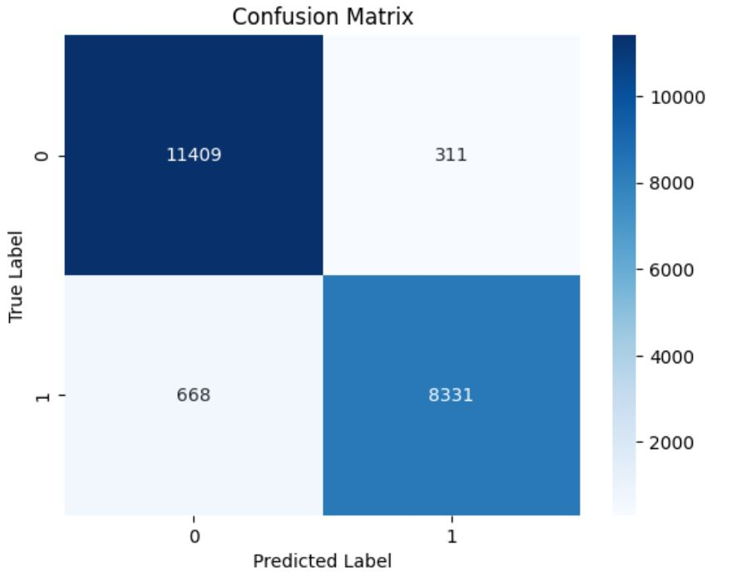
Results - Confusion Matrix

Slide 39
Random Forest Classification
Divides dataset into random subsets
Apply Decision Tree on all subsets
Based on Voting, generate class label
Hyper parameter tuning with RandomizedSearchCV
RandomizedSearchCV to randomly chooses any hyper parameter value from the list and apply

Slide 40
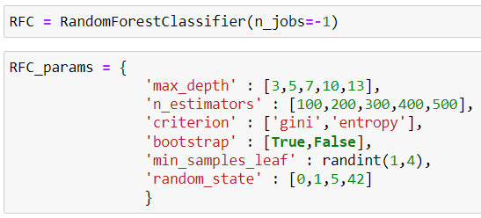
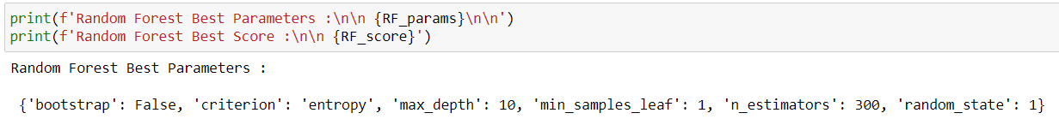
Random Forest Classification
Hyper parameters:
n_estimators
max_depth
criterion
bootstrap
min_samples_leaf

Slide 41
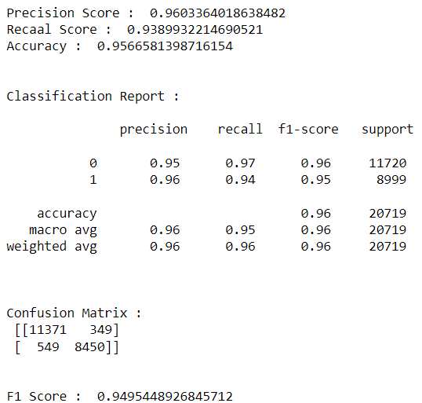
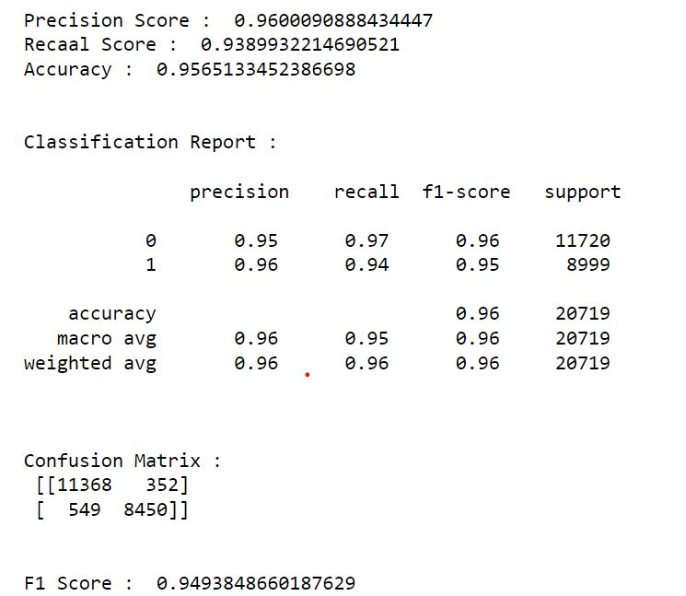
Results
Before Hyper parameter tuning
After Hyper parameter tuning

Slide 42
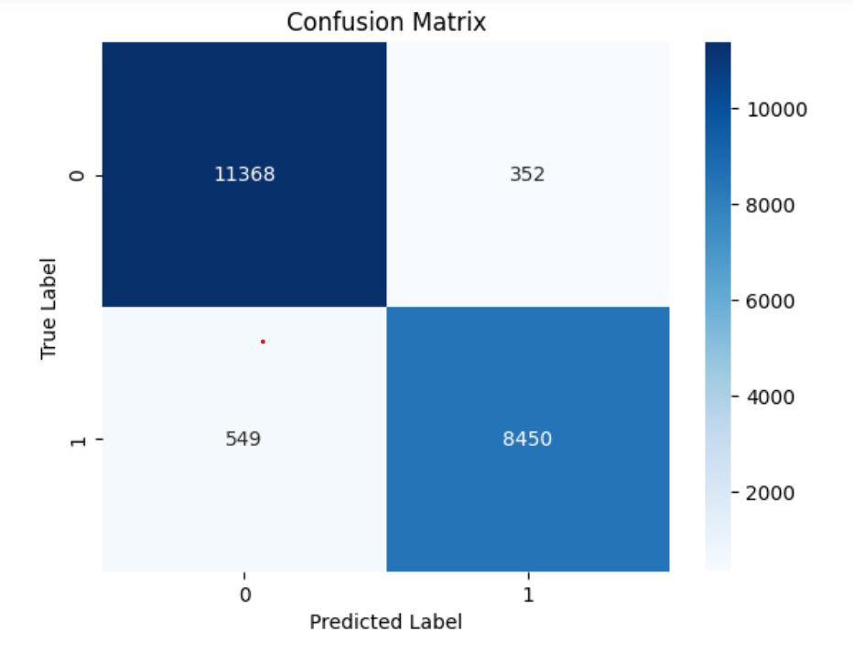
Results - Confusion Matrix

Slide 43
06
Results

Slide 44
Comparison Table
 | Without Hyper-parameter Tuning | With Hyper-parameter Tuning
DecisionTreeClassifier - GridSearchCV | 0.935 | 0.945
RandomForestClassifier - RandomizedSearchCV | 0.949 | 0.953

Slide 45
07
Conclusion

Slide 46
Conclusion
The insights gained from the project can be utilized by the airline industry to improve their services and meet customer expectations.
By identifying the areas where customers are dissatisfied, the airline companies can make improvements to provide better services to their customers, ultimately leading to higher customer satisfaction and loyalty.
Overall, the project demonstrated the potential of machine learning techniques to analyze customer feedback data and predict customer satisfaction levels.

Slide 47
08
References

Slide 48
References
Airline Passenger Satisfaction. (n.d.). Retrieved April 22, 2023, from https://www.kaggle.com/datasets/teejmahal20/airline-passenger-satisfaction
R, S. E. (2021, June 17). Understand Random Forest Algorithms With Examples (Updated 2023). Analytics Vidhya. https://www.analyticsvidhya.com/blog/2021/06/understanding-random-forest/
Raj, A. (2021, December 11). An Exhaustive Guide to Decision Tree Classification in Python 3.x. Medium. https://towardsdatascience.com/an-exhaustive-guide-to-classification-using-decision-trees-8d472e77223f
Us falcon airline passenger satisfaction. (n.d.). Retrieved April 22, 2023, from https://www.slideshare.net/Mithileshyadav11/us-falcon-airline-passenger-satisfaction

Slide 49
Thanks!
Do you have any questions?
Please keep this slide for attribution

